Slide 1
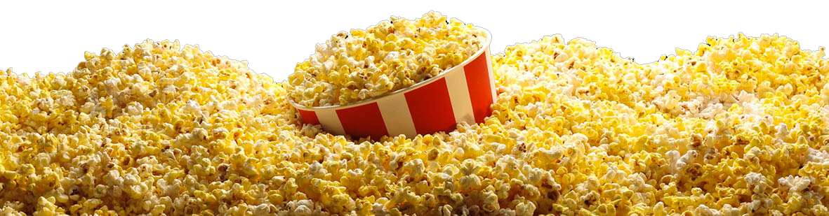
POPCORN
This Photo by Unknown Author is licensed under CC BY-NC
How Many More? How many fewer?

Slide 2

Charlie—The champion
Top Popcorn Sales in his town 2023
Likes to win

Slide 3
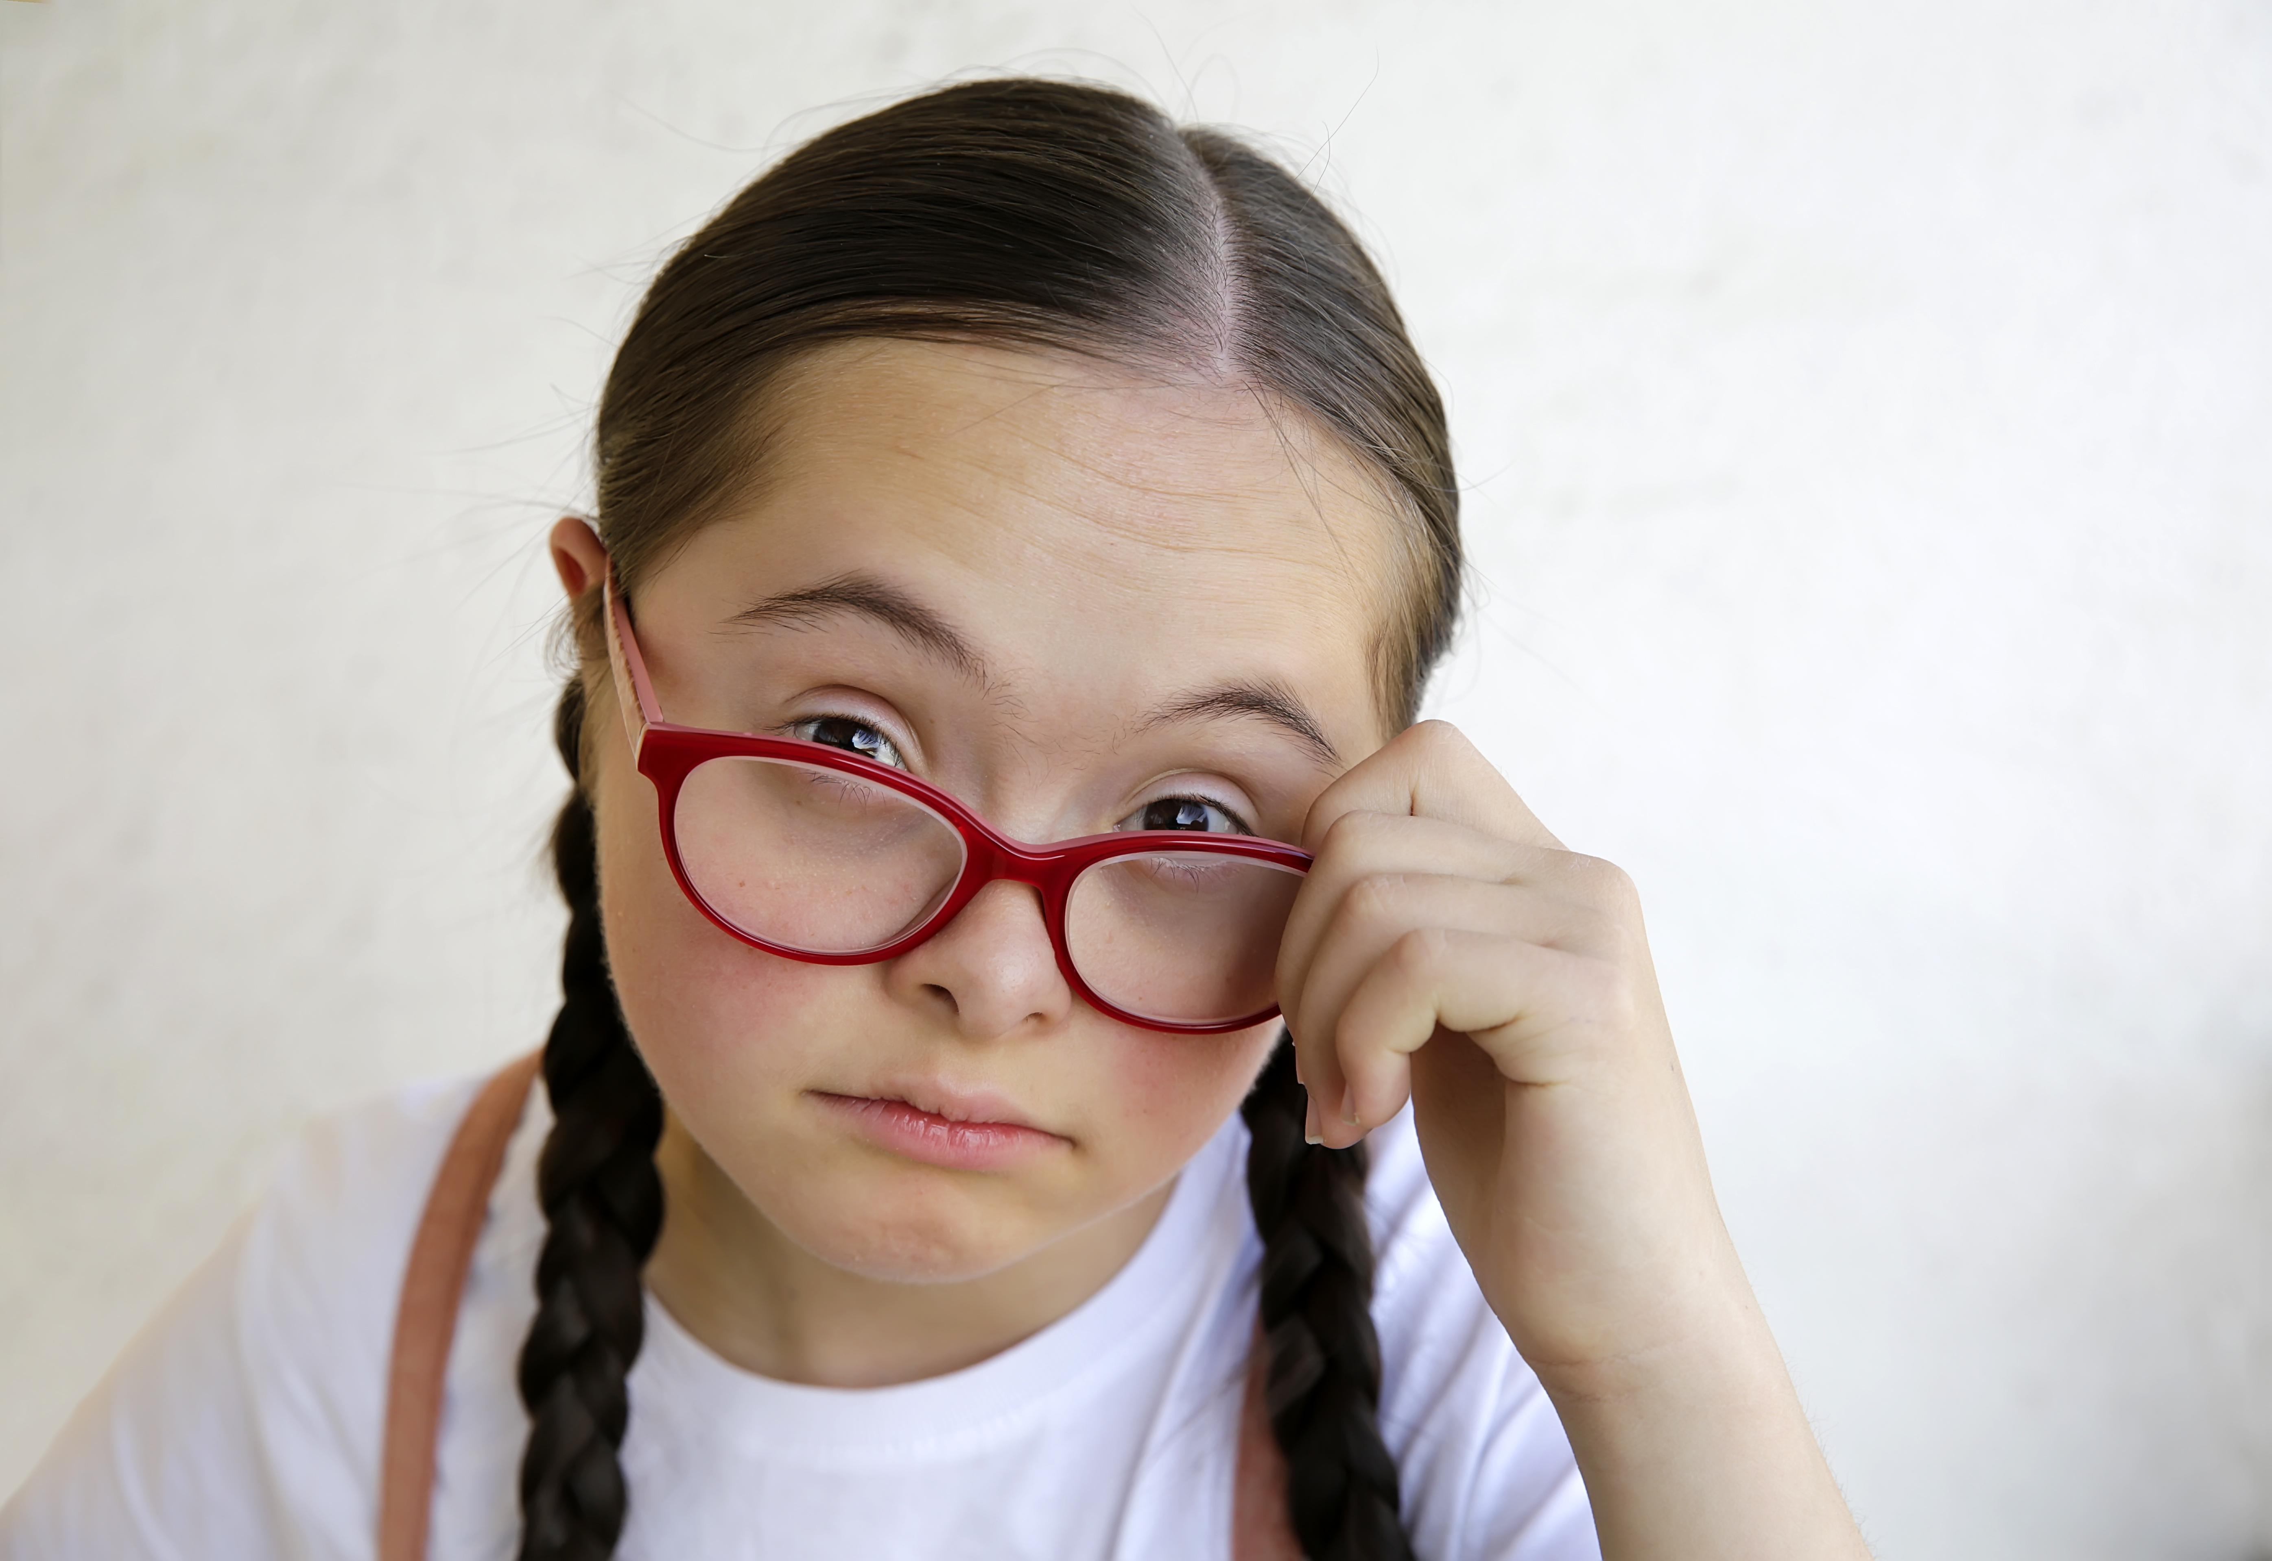
Suzie: the challenger
Second place popcorn Sales 2023
Wants a win
Charlie’s sister

Slide 4
Charlie has sold 12 tubs of popcorn.
Suzie has sold 8 tubs of popcorn.
Question 1: Who is winning the contest?

Slide 5
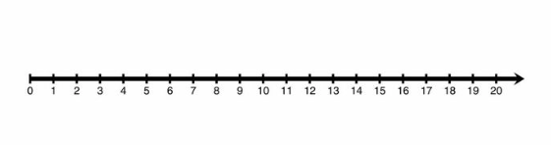




Charlie has sold 12 tubs of popcorn.
Suzie has sold 8 tubs of popcorn.
Question 2: HOW MANY MORE tubs of popcorn has Charlie sold than Suzie?
Or: HOW FAR AHEAD is Charlie?

Slide 6

Charlie: ready for the win
Feeling Confident
Ahead by 4 tubs
Tells Suzie he sold 12

Slide 7



Mrs. SMITh:the neighbor
Lives in the house next to Suzie and Charlie
Been on vacation in Florida for two months. Returned last night
THE PLOT THICKENS...THE DOORBELL RINGS….

Slide 8
My brother and I are selling popcorn…and I’m way behind!

Slide 9
“Oh, I hate to see you so upset. How can I help? ”
Question 3: “Suzie, how many fewer tubs of popcorn have you sold than Charlie?

Slide 10

Charlie has sold 12 tubs of popcorn.
Suzie has sold 8 tubs of popcorn.
Question 2: HOW MANY FEWER tubs of popcorn has Suzie sold than Charlie?
Or: HOW FAR behind is Suzie?

Slide 11
“I’ll take 4!”

